Slide 1
Numerical Computing in Python with Numpy and Scipy
Chris Cooling
Graduate School Senior Teaching Fellow

Slide 2
Important Information on Marking your Attendance on Inkpath I will show you a QR code at the end of the session allowing you to mark your attendance on Inkpath. Please do not mark your attendance until then. If you are a Postgraduate Research student, this is required for receiving your Graduate School credit for this course.
Notes:
No additional notes.

Slide 3
Learning Outcomes
Describe the key functionality and advantages of NumPy and SciPy
Utilise NumPy arrays to store and perform operations on data sets
Locate appropriate SciPy functions for a specific problem
Create basic programs using NumPy and SciPy to solve numerical problems

Slide 4
Notebook Links
What Are NumPy and SciPy
Creating and Manipulating NumPy Arrays
Array Operations
Calculus
Built-In Functions
Initial Value Problems
Other Features
Performance Comparison
Projects

Slide 5
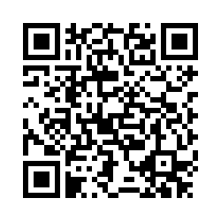
Feedback
Once you’ve completed this course, please provide feedback
The link is https://tinyurl.com/feedback-rcds
You should also have received an email with this link
This helps us improve the class for future students

Slide 6
Numerical Computing in Python with Numpy and Scipy
Distributed under Creative Commons Attribution-NonCommercial-ShareAlike 4.0 International

